Slide 1



Introduction to target capture based sequencing methods for emerging pathogen detection
Ayanda Nzimande
Respiratory Virus Genomics Workshop
12 September 2025
Centre for Respiratory Diseases and Meningitis,
National Institute for Communicable Diseases,
A division of the National Health Laboratory Service

Slide 2
Case Study: Suspected Novel Virus in a School Outbreak
National Influenza Reference Laboratory – Response Scenario

Slide 3
Scenario Background
20 children at a school present with acute respiratory illness in one week
Routine PCR tests (influenza A/B, SARS-CoV-2, RSV, adenovirus) are negative
Two learners were hospitalized with severe pneumonia
Samples referred to National Influenza Reference Laboratory

Slide 4
QUESTIONS
Q1: What would you do first if you were the lab scientist receiving these samples?
Q2: If your lab could only run one method, which would you choose — Target capture sequencing or amplicon based sequencing, why?

Slide 5
Q3: You discover a novel orthomyxovirus How would you confirm this finding before reporting it?
Q4: How would you word the lab report to clinicians?
Q5: What is the most urgent next step — case finding, data sharing, or risk assessment?

Slide 6
Q1. First steps upon receiving samples
Confirm sample integrity (transport, storage, collection dates)
Repeat PCR assays to rule out technical errors
Notify public health authorities: an investigation is underway
Q2. Target capture vs amplicon based
Broad pathogen detection: Unlike amplicon-based sequencing (which requires primers designed for known regions), capture probes can enrich both known and novel pathogens, making it more useful for emerging infectious disease surveillance.
Reduced bias: Amplicon approaches can fail if there are mutations in primer binding sites, while capture probes are more tolerant to sequence variability.
Greater genome coverage: Particularly valuable for highly variable viruses, where complete or near-complete genomes are essential for phylogenetics and tracking evolution.

Slide 7
Q3. Confirmation of findings
Confirm with repeat sequencing
Enhance biosafety for further handling
Share provisional sequence data with WHO collaborators
Q4. lab report to clinicians
Report as “Sequences consistent with novel orthomyxovirus, confirmation pending”
Highlight diagnostic confirmation is ongoing
Recommend immediate infection prevention in school and hospital

Slide 8
Q5. Urgent next steps
Case finding: test school contacts, family members, etc
Upload sequences to GISAID/GenBank (after review)
Risk assessment: transmissibility, severity, similarity to known viruses
Collaboration: notify WHO and GISRS network
Exercise complete ☺

Slide 9
Introduction to target capture based sequencing methods for emerging pathogen detection
Ayanda Nzimande
Respiratory Virus Genomics Workshop
12 September 2025
Centre for Respiratory Diseases and Meningitis,
National Institute for Communicable Diseases,
A division of the National Health Laboratory Service

Slide 10
Introduction
Accurate and rapid detection of infectious agents is crucial for outbreak response
SARS-CoV-2 pandemic highlighted the importance of unbiased identification and characterization of pathogens
Targeted multi-pathogen PCR methods widely used for the targeted detection of known common pathogens
High sensitivity and specificity
Rapid identification of known pathogens
Do not detect novel and emerging pathogens
Hybridization capture-based sequencing methods can identify novel and emerging viruses by capturing and sequencing all viral sequences
Metagenomic Next-Generation Sequencing (mNGS) offers hypothesis-free sequencing of all nucleic acids in a sample, including pathogen genomes.
Knyazev et al., 2020; Kapoor et al., 2024; Carbo et al., 2020; Williams et al., 2018
Notes:
Additionally, the use of Metagenomic Next-Generation Sequencing (mNGS) can be used, which facilitates hypothesis-free sequencing of all nucleic acids in a sample. But one needs to consider that the detection of microorganisms by metagenomic sequencing comes with the challenge of proving their existence but not their pathogenicity because it is difficult to distinguish normal microbiota, contamination, or pathogens.
Hypothesis-free sequencing is a broad genomics technique that analyzes all genetic material in a sample to identify unknown DNA or RNA sequences without a prior hypothesis about what to expect.

Slide 11
Respiratory Pathogen ID/AMR enrichment panel (RPIP)
NGS -based respiratory pathogen enrichment kit that targets (180+ bacteria, 50+ fungi, and 40+ viruses) and 2000 (AMR) markers in a single assay
Advantages
Detection and subtyping of whole genomes of seasonal influenza A and B viruses, including 3 avian influenza subtypes (H5N1, H7N9 & H9N2)
Whole genome of SARS-CoV-2
Co-detection of respiratory pathogens and AMR in a single specimen can be achieved
Limitations
Only provides WG for SARS-COV-2 and influenza
Cost
Time it takes to get a result (~5 days)

Slide 12
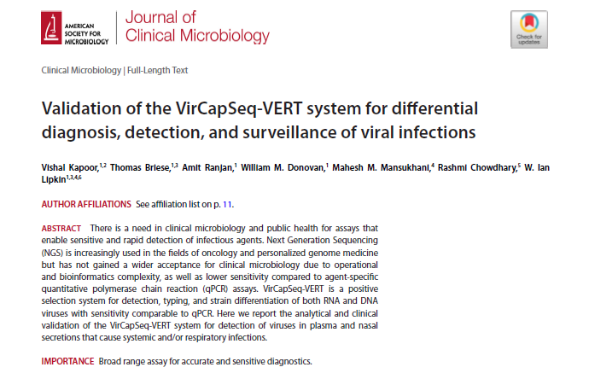
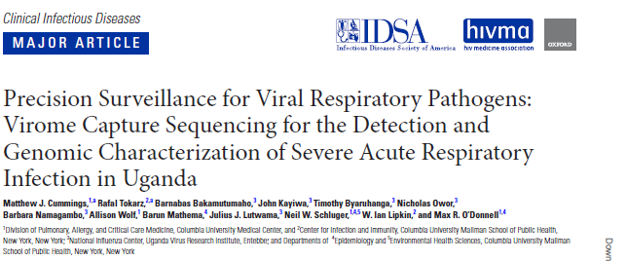
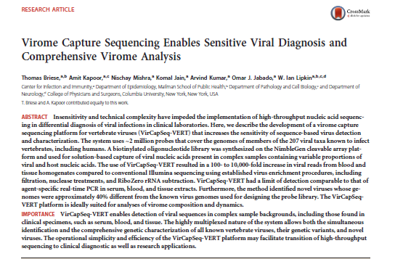
VirCapSeq-VERT
~1M biotinylated probes covering all viral taxa known to infect vertebrates
Designed to “capture” all viral genomes
1,000-fold higher sensitivity compared to unbiased sequencing methods
Covers all sequences published in Genbank, RefSeq, EMBL, or GISAID
Validated for respiratory samples, blood, CSF, and organ tissues
Rapid Identification of Microbes (RIM) bioinformatics pipeline
Notes:
VirCapSeq-VERT is a positive-selection capture sequencing method composed of ~1M biotinylated probes covering all viral taxa known to infect vertebrates.
It’s technology is designed to “capture” all viral genomes, reducing the signal-to-noise ratio and resulting in a 1,000-fold higher sensitivity compared to unbiased sequencing methods.
The panel of oligonucleotide probes covers all sequences published in Genbank, RefSeq, GISAID. (Additionally, it was updated in May 2021 to include probes for newly reported sequence entries, including the novel SARS-CoV-2 virus.)
It has received clinical validation for the analysis of blood and respiratory samples, CSF, and organ tissues however it has also demonstrated powerful results on other sample types including urine, stool, and wastewater. As well as shown to be used in other countries as shown in the publications below.
Data analysis can be conducted using a streamlines bioinformatics pipeline called The Rapid Identification of Microbes (RIM) which will be discussed in a few slides.

Slide 13
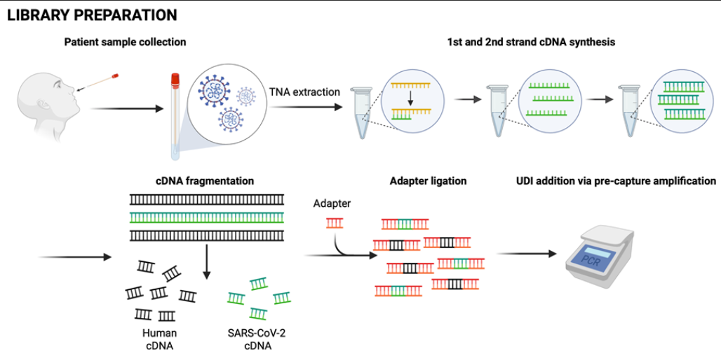
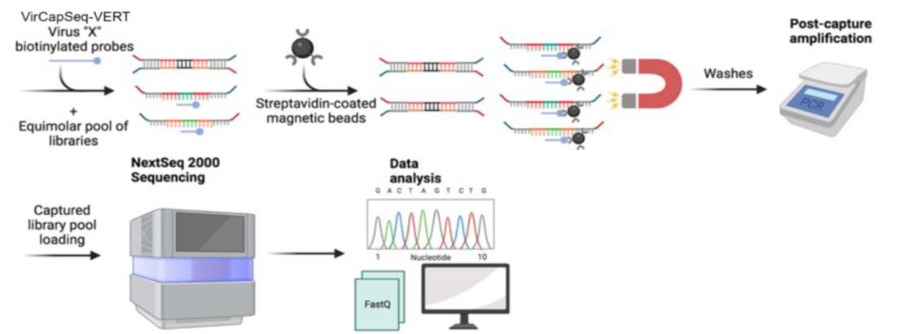
VirCapSeq-VERT workflow
Extraction & PCR
Library Preparation
Hybridization & Capture
Sequencing & Data analysis
Notes:
The key feature of the VirCapSeq protocol is when the hybridization occurs between the Vircapseq biotylated probes and the prepared libraries allowing your target viral genomes to be captured. Now this probe is conjugated through streptavidine to magnetic beads which essentially enhances capturing during the wash step by using a magnet to pull down your beads that contain your target libraries by washing off host and bacterial noise during the wash step.
Your captured libraries are then amplified and prepared for sequencing on a nextseq 1000/2000, aiming to target range a range of 10 million raw reads per sample. The final output results in fastQ files that are ready to be analyzed, and these can be analysed on any bioinformatics pipeline.

Slide 14
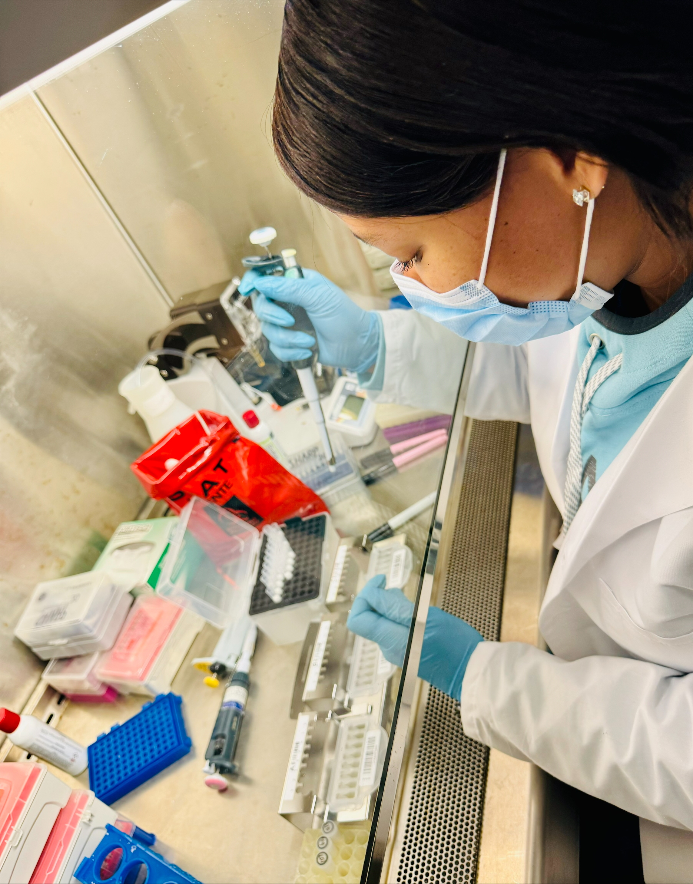
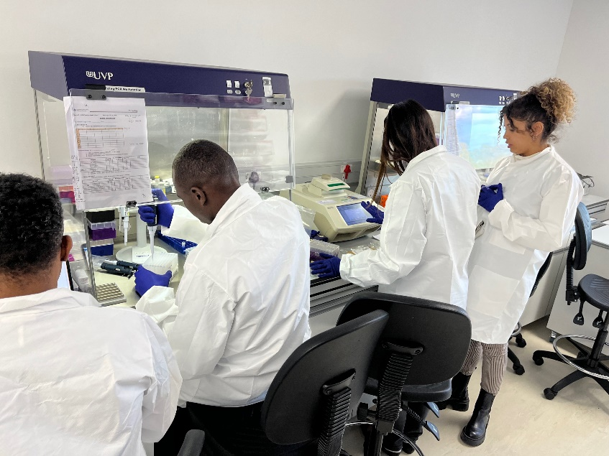
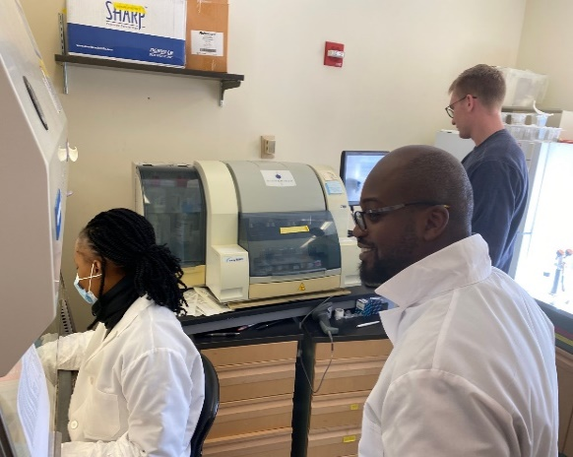
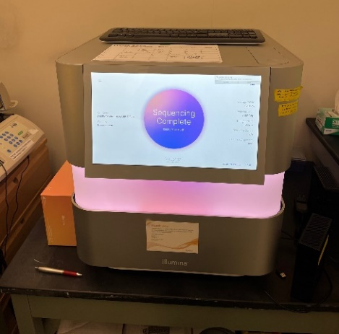
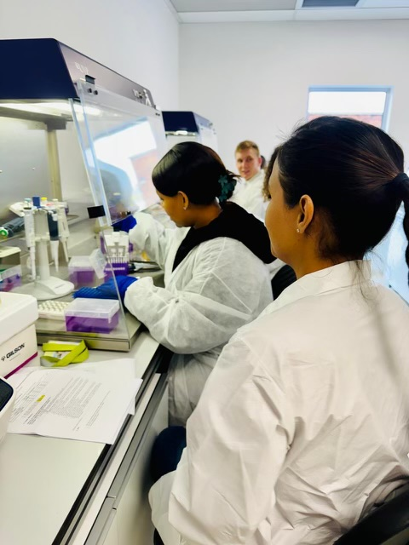
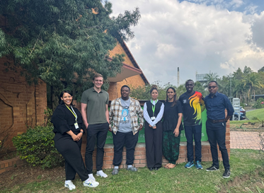
Global Alliance for Preventing Pandemics, New York, 25 March- 5 April 2024
Training
National Institute for Communicable Diseases, South Africa,15- 26 April 2024
Tested stool samples from Zambia as part of an enhanced diarrheal surveillance study
Tested respiratory samples from the Pneumonia Surveillance Programme, together with trainees from Kenya

Slide 15
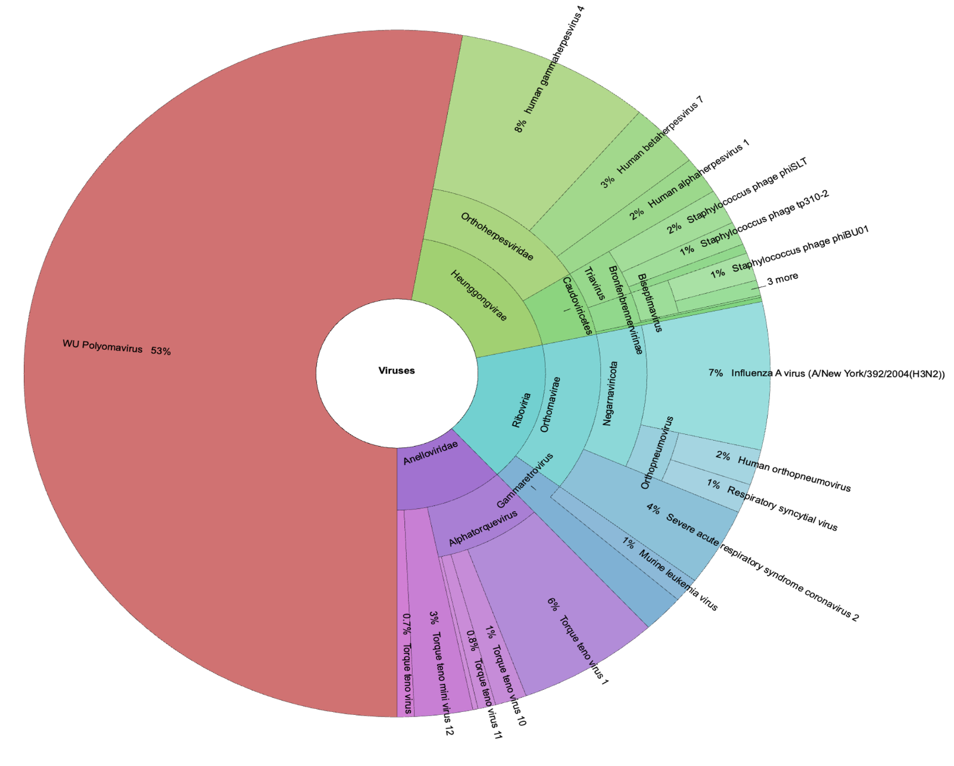
Preliminary Results – Sample 86
Seegene Allplex™ SARS-CoV-2/FluA/FluB/RSV assay (Ct)
Influenza A (28)
Influenza B (32)
BioFire® FilmArray Respiratory PCR Panel 2.1 plus
Influenza A
Influenza B
Coronavirus OC43
TaqMan Array Card (TAC) RP (Ct)
- No viruses detected
VirCapSeq-VERT Results
Krona plot- 53% reads mapped to WU polyomavirus
WU polyomavirus at 76% genome coverage, 2123 reads
Influenza A at 20% genome coverage, 100 reads

Slide 16
Percentage genome coverage of avian influenza viruses using VirCapSeq-VERT (N=7)

Slide 17

Limitations
Establishing quality criteria parameters
Identifying clinically relevant pathogens
limited validation for pathogen discovery
Time to result ~5 days
Cost

Slide 18
Take home message
VirCapSeq-VERT and RPIP
-Additional tools for investigation of outbreaks or clusters of cases with unknown aetiology
Enables simultaneous pathogen detection, characterization, and genome recovery of all viruses within a sample
A potential tool for novel pathogen discovery

Slide 19
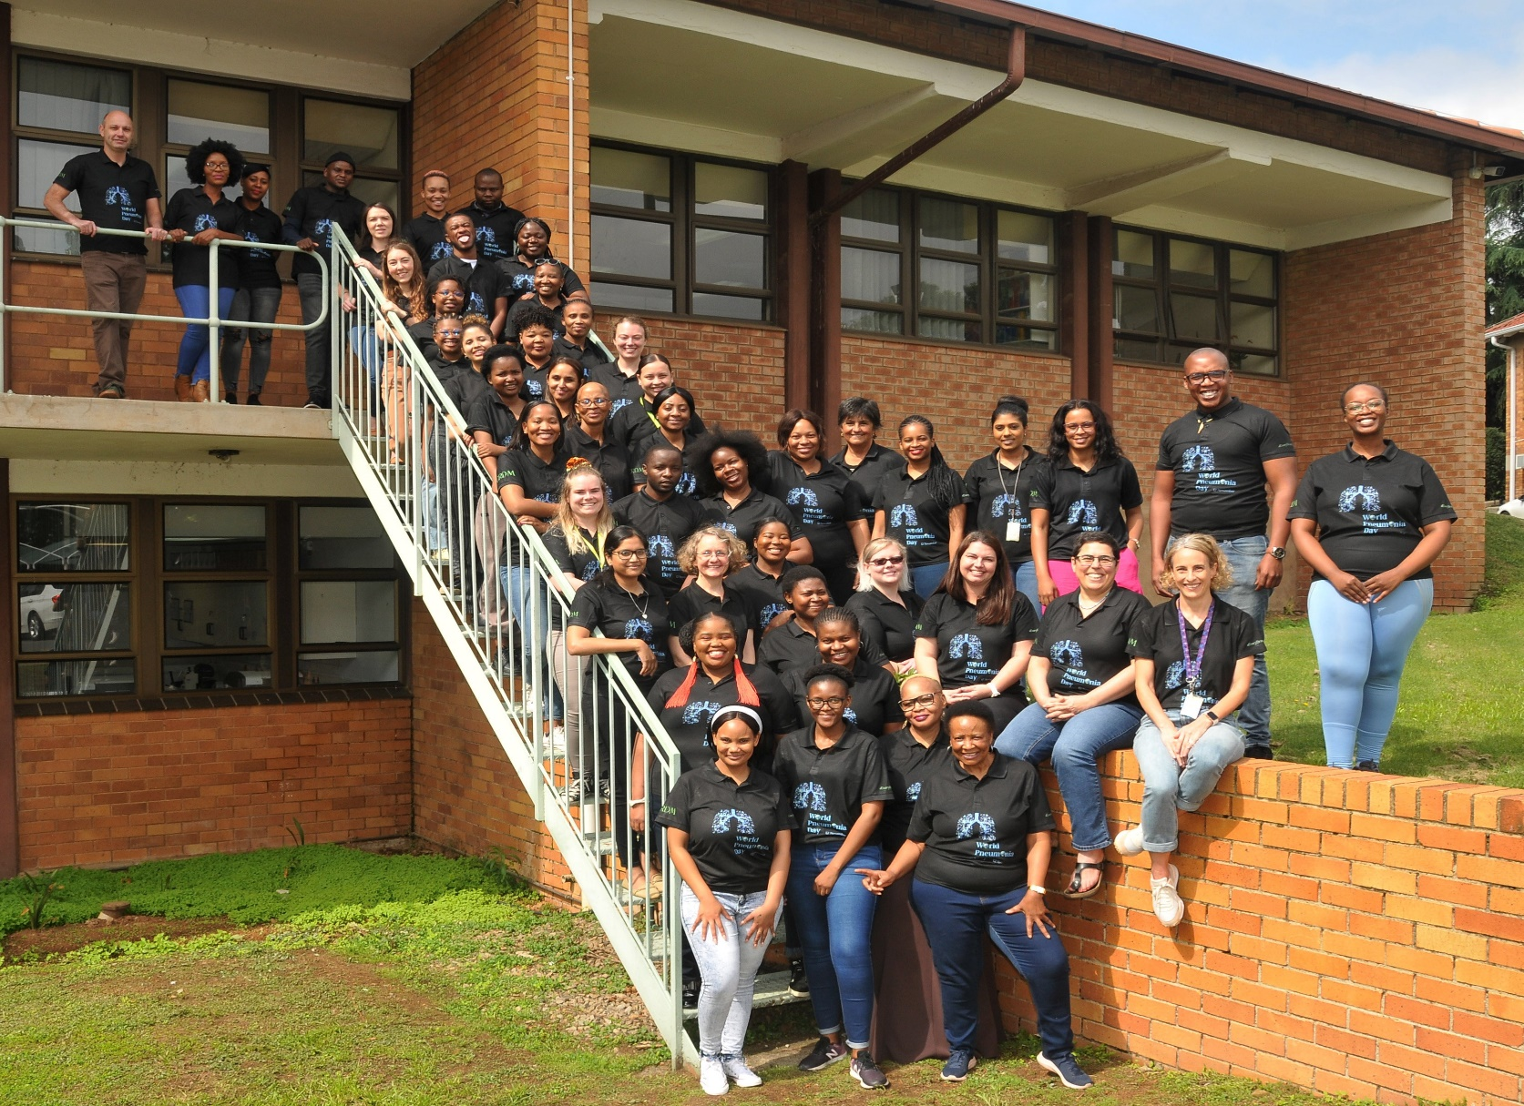


Acknowledgments

